Slide 1
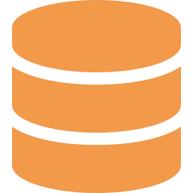
DATABASE SYSTEMS PROJECT
Design and Implementation of a Database
Management System for Multi-Warehouse
Stock Transfer Management
A centralized data architecture for tracking, approving, and reconciling stock movements across distributed warehouse locations in real time.
Warehousing
Inventory Control
Relational Databases
Logistics
Notes:
Good [morning/afternoon]. Today I will present the design and implementation of a database management system for a multi-warehouse stock transfer management system — how a centralized database lets organizations track, approve, and reconcile stock movements between warehouse locations in real time.

Slide 2
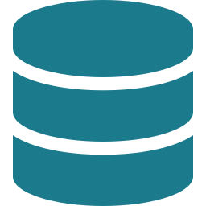

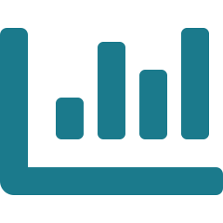





INTRODUCTION
Problem Statement & Objectives
PROBLEM STATEMENT
PROJECT OBJECTIVES
Organizations running multiple warehouses must move stock between locations to meet demand and avoid stockouts. Spreadsheets and disconnected local systems cannot keep pace with concurrent transfers, approvals, and audits across sites, resulting in:
The system is designed to directly resolve these gaps through a single, transaction-safe database shared by every warehouse:
Centralized Data Store
Delayed Visibility
One relational schema shared by every warehouse, eliminating duplicate local records.
Stock counts update hours or days after a physical transfer occurs.
Real-Time Stock Visibility
Manual Reconciliation
Live on-hand and in-transit quantities per SKU, per location, at all times.
Staff cross-check paper logs and spreadsheets across warehouses.
Controlled Transfer Workflow
Data Inconsistency
Enforced request → approval → dispatch → receipt sequence with audit trail.
Duplicate or conflicting stock records appear across systems.
Data Integrity & Security
Stockouts & Overstock
Referential integrity, transactions, and role-based access protect stock records.
Poor visibility leads to imbalanced inventory across locations.
Multi-Warehouse Stock Transfer DBMS
2
Notes:
This slide lays out the problem statement on the left and our objectives on the right. Organizations running multiple warehouses must move stock between locations to meet demand and avoid stockouts, but spreadsheets and disconnected systems cannot keep pace with concurrent transfers, approvals, and audits. That results in four concrete problems: delayed visibility into stock counts, manual reconciliation of paper logs, data inconsistency across systems, and stockouts or overstock from poor visibility. Our objectives directly answer these: a centralized data store shared by every warehouse, real-time stock visibility, a controlled request-approval-dispatch-receipt workflow with an audit trail, and strong data integrity and security through transactions and role-based access.

Slide 3


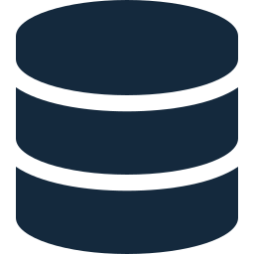
SYSTEM DESIGN
Architecture & Database Design
THREE-TIER ARCHITECTURE
CORE DATABASE ENTITIES
Presentation Layer
WAREHOUSE
PRODUCT
Web & desktop clients for staff and managers to raise and track transfers.
warehouse_id (PK), name, location
product_id (PK), name, category
STOCK_TRANSFER
Application Layer
transfer_id, source/dest_wh_id,
product_id, qty, status
Business logic, approval rules, and REST APIs coordinating warehouses.
STOCK
USER
stock_id (PK), warehouse_id (FK),
product_id (FK), quantity
user_id (PK), name, role,
warehouse_id (FK)
Database Layer
Central relational database storing warehouses, products, and stock.
Multi-Warehouse Stock Transfer DBMS
3
Notes:
On the left is our three-tier architecture: a presentation layer of web and desktop clients, an application layer holding the business logic and REST APIs, and a database layer that is the single central store for warehouses, products, and stock. On the right is the core of the database design: WAREHOUSE, PRODUCT, STOCK, and USER entities all connect through the central STOCK_TRANSFER table, which records the source and destination warehouse, product, quantity, and status for every movement.

Slide 4






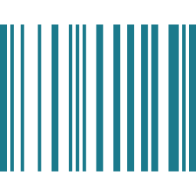
WORKFLOW & IMPLEMENTATION
Transfer Workflow & Technology Stack
STOCK TRANSFER PROCESS
Request
Approval
Dispatch
In Transit
Received
Every transition is a database transaction, so stock quantities never fall out of sync between source and destination warehouses.
TECHNOLOGY STACK
Database Engine
Backend Services
Client Interfaces
Data Capture
Access Control
MySQL / Oracle for schema, constraints & transactions.
Java / Python REST APIs for transfer logic.
Web dashboard & desktop terminals.
Barcode scanning at dispatch & receipt.
Role-based permissions for all users.
Multi-Warehouse Stock Transfer DBMS
4
Notes:
This shows the full transfer process: a request is raised, a manager approves it, the source warehouse dispatches the stock, it is tracked while in transit, and the destination confirms receipt, which updates both warehouses stock levels. Every step is a database transaction, so quantities never fall out of sync. Underneath, the technology stack: MySQL or Oracle for the database engine, Java or Python REST APIs for the backend, web and desktop clients for users, barcode scanning to reduce entry errors at dispatch and receipt, and role-based access control to separate requesters, approvers, and admins.

Slide 5

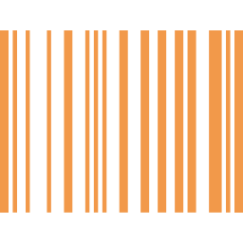

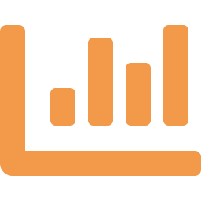

CONCLUSION
Benefits & Future Scope
KEY BENEFITS
FUTURE SCOPE
Single, consistent view of stock across every warehouse
RFID / barcode integration for automatic stock capture
Faster, auditable transfer approvals and dispatch
Mobile app for on-the-floor transfer approvals
Fewer stockouts through accurate real-time quantities
Predictive analytics to forecast inter-warehouse demand
Reliable reporting for demand and replenishment planning
Cloud deployment for multi-region scalability
Thank You
Notes:
To close — the key benefits are a single consistent view of stock across every warehouse, faster auditable approvals, fewer stockouts, and reliable data for demand planning. Looking ahead, this could be extended with RFID or barcode integration for automatic capture, a mobile app for floor-level approvals, predictive analytics to forecast inter-warehouse demand, and cloud deployment for multi-region scale. Thank you — happy to take questions.

